Slide 1
FitMe!
Johnny, Abhi, Ani, Dom

Slide 2
Problem Overview
A personalized health assistant that addresses user’s fitness goals.
A system that helps users to pursue healthy choices with respect to physical exercises & diet.

Slide 3
Evolution of Our Ontology
To effectively use the targets and targetedBy properties in queries involving exercises and muscle groups, we reevaluated their implementation. Previously, these properties were assigned to the exercise and muscleGroup classes, but this setup prevented the reasoner from inferring the inverse properties.
With guidance from Danielle and Jade, we shifted to creating instances for each muscle and exercise, directly applying the properties to these instances. This change allowed the reasoner to infer inverse properties properly, making them usable in our queries.

Slide 4
Question 1:
A: [The system will recommend a workout cycle and meals for the user to do, see below for an example.]
Workout Plan:
Upper Body Push
Bench Press
Overhead Shoulder Press
Lateral Raises
Tricep Pushdowns
Core: Seated Ab Crunches
Core and Low-Impact Lower Body
Planks
Seated Leg Extensions
Bodyweight Glute Bridges
Upper Body Finisher: Push-Ups
Mobility Work: Gentle knee stretches
Upper Body Pull
Lat Pulldown
Seated Rows
Bicep Curls
Face Pulls
Core: Russian Twists
Active Recovery/Low Impact Cardio
Swimming or Stationary Cycling
Stretching and Mobility Work
DO NOT: Deadlift
Heavy Front Squats
RDL’s
Bulgarian Split Squats
Recommended Meals:
Chicken and Sweet Potato Bowl
Grilled chicken breast
Roasted sweet potatoes
Steamed broccoli
Drizzle of olive oil and sprinkle of salt and pepper
Greek Yogurt with Berries and Granola
1 cup Greek yogurt (high protein)
Mixed berries (antioxidants and carbs)
¼ cup of granola or oats
Drizzle of honey
Roasted Veggie Medley
A variety of vegetables (carrots, zucchini, bell peppers, broccoli, and sweet potatoes)
Olive oil
Herbs and spices (salt, pepper, garlic powder, or Italian seasoning)
Egg and Vegetable Scramble
Eggs or egg whites
A mix of vegetables (spinach, tomatoes, bell peppers, mushrooms, onions)
Cheese (optional)
Salt and pepper
Q:What is the good routine I can follow if I want to lose fat and gain muscle given that I have a knee injury? (Users will enter their age, weight, height, sex, physical condition, etc.. - for more info see scope above. The goal will be selected from a drop down menu.)

Slide 5
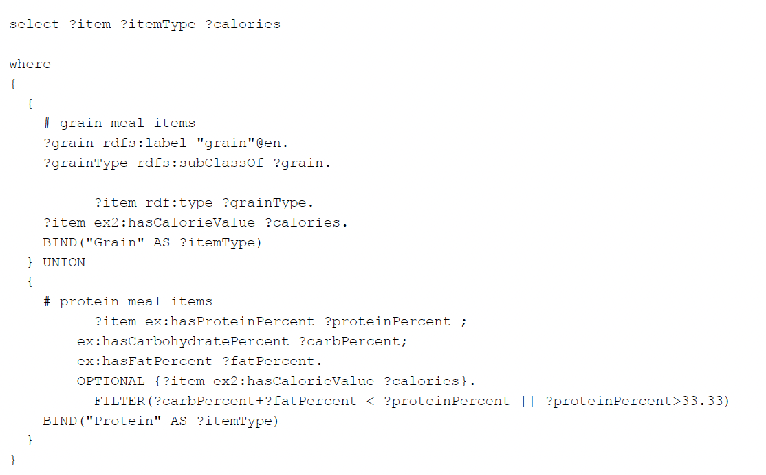
SPARQL for Question 1

Slide 6
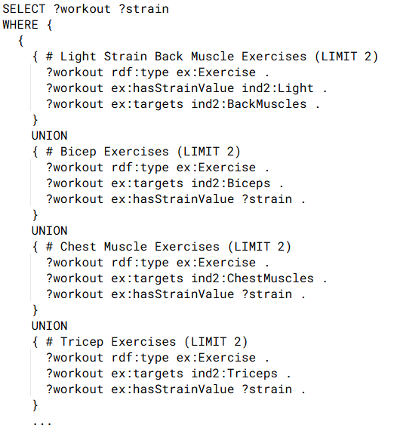
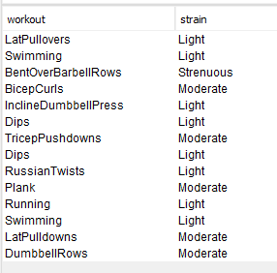
SPARQL for Question 1 continued..
Link To The Query

Slide 7
Question 2:
A: [The system will recommend a back workout for the user that works around their condition.]
Workout Plan:
Upper Body Pull 1
Lat Pulldown
Seated Rows
Bicep Curls
Face Pulls
Upper Body Pull 2
Pull ups
Superman
Dumbbell Row
Wall Angels
DO NOT: Deadlift
Overhead Press
Barbell Back Squats
Bent over row
Q: I’m looking into strengthening my back. Can you provide me with a back workout? (User has already stated that they have scoliosis when creating their profile. System knows that the user has this condition.
Users will enter their age, weight, height, sex, physical condition, etc.. - for more info see scope above).

Slide 8
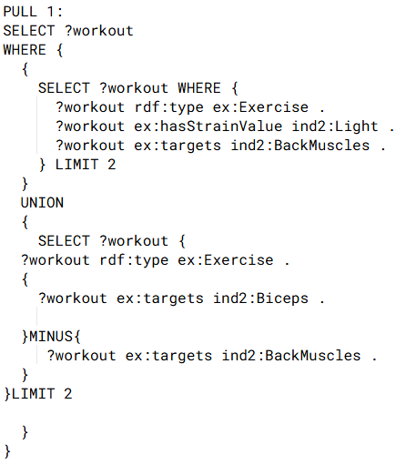
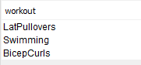
SPARQL for Question 2

Slide 9
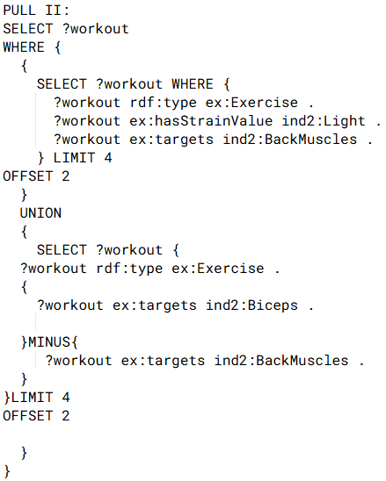
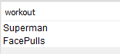
SPARQL for Question 2 cont.

Slide 10
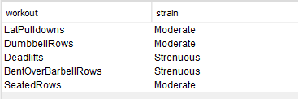
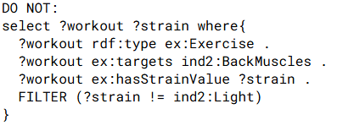
SPARQL for Question 2 cont.

Slide 11
Question 3:
A: [The system will recommend a leg workout for the user that works around their condition.]
Error: Please change your goal since are no available exercises
[Re-enter Goal] [Show Anyways]
(These are buttons, highlighted shows what was clicked)
Workout Plan:
Lower Body 1
Seated Leg Extensions (light weight)
Glute Bridges (with minimal resistance)
Standing Calf Raises (with support)
Modified Bodyweight Step-Ups (low height)
Lower Body 2
Side-Lying Leg Lifts (gentle)
Wall Sits (short duration)
Resistance Band Leg Press (light resistance)
Gentle Hamstring Stretches
Recommended Meals:
Mediterranean Quinoa Bowl
Cooked quinoa
Diced cucumber and cherry tomatoes
Kalamata olives and feta cheese (optional)
Chopped parsley
Olive oil and lemon juice dressing
Stuffed Bell Peppers
Bell peppers, halved and deseeded
Filling of cooked rice, black beans, corn, and diced tomatoes
Season with cumin, chili powder, and garlic
Bake until the peppers are tender
Vegetable Lentil Curry
Red or green lentils
Diced tomatoes and coconut milk
A mix of vegetables (spinach, carrots, and bell peppers)
Curry powder and ginger
Serve with brown rice or naan
Q: I’m looking to develop strong legs. Can you provide me with a workout plan and vegetarian meal recommendations? (User has already stated that they have a mild leg strain when creating their profile. The system knows that the user has this condition. Users will enter their age, weight, height, sex, physical condition, etc. - for more info see scope above).

Slide 12
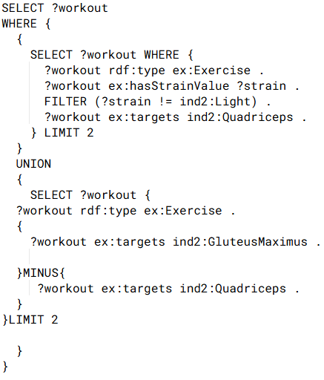
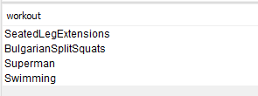
SPARQL for Question 3

Slide 13
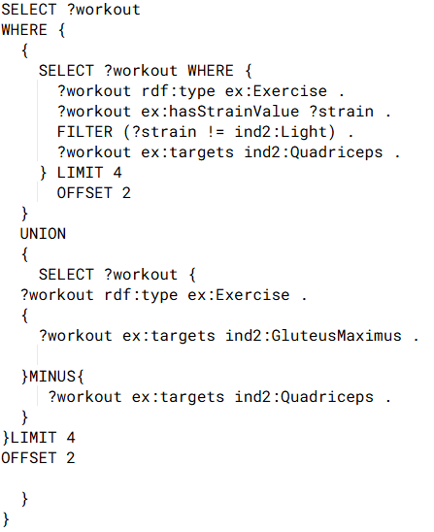
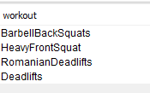
SPARQL for Question 3 cont.

Slide 14
Thank you

